Slide 1



PEILab Group Meeting
Leader: Zicong Hong
Team Member: Jian Lin, Haodong Wang, Qianli Liu, Kaibin Guo, Junjie Liu

Slide 2
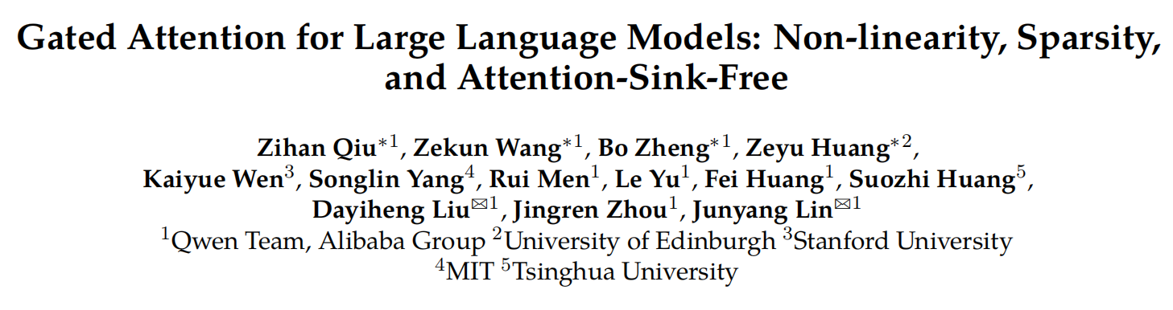
Gated Attention
NeurIPS’26 Oral

Slide 3
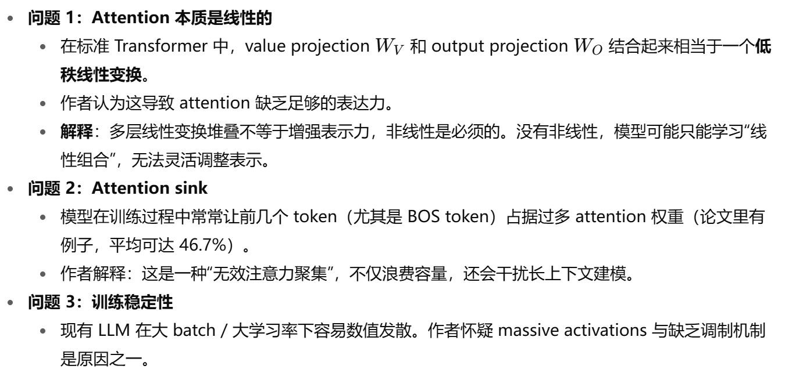
Gated Attention
Motivation

Slide 4
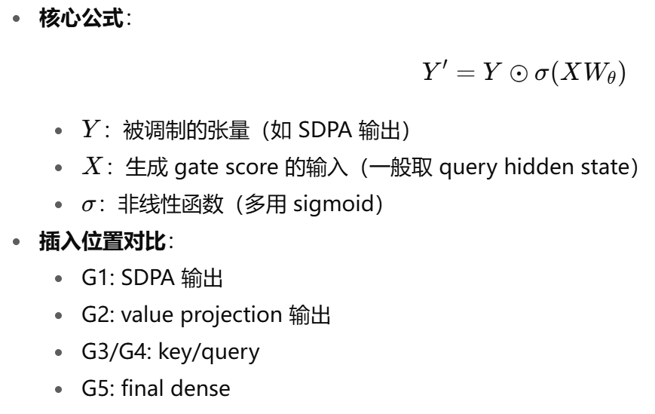
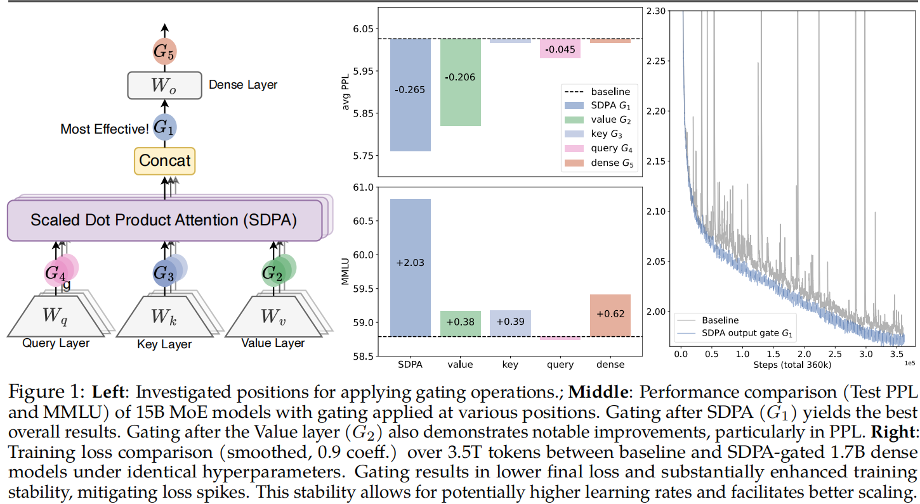
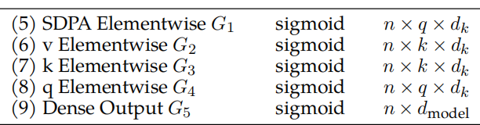
Gated Attention
Gated Attention

Slide 5
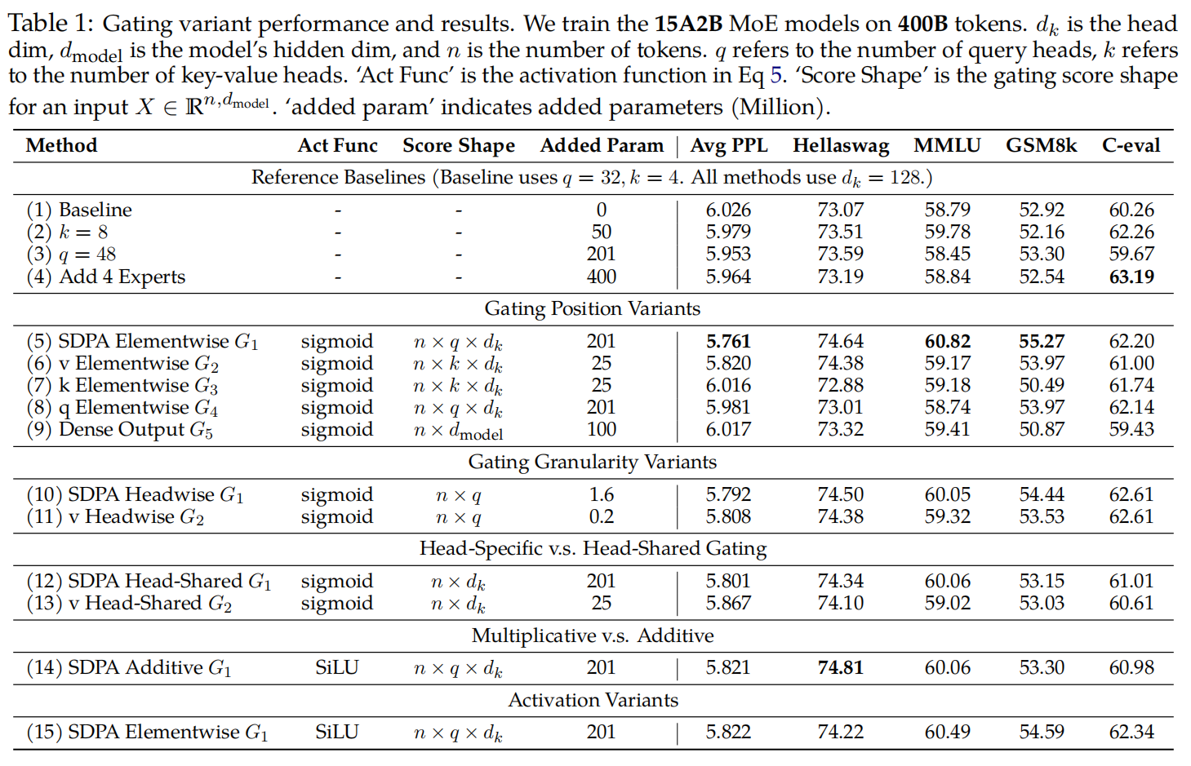
Gated Attention
Experiment(Gated Attention for MoE models)
(i) SDPA and value output gating are effective. Inserting gates at the output of SDPA (G1) or the value map (G2) is the most effective, achieving lower PPL and better overall benchmark performance than other variants.
(ii) Head-Specific Gating Matters. Applying headwise gating at G1 and G2 introduces very few additional parameters (less than 2M for the MoE-15A2B model) but still delivers substantial improvements (rows 10 and 11). When sharing gating scores across different attention heads (we average over the query head dimension q to obtain an n × dk score from the original n × q × dk), the benchmark improvements are smaller than those achieved by headwise gating (row 12 v.s. 10, 13 v.s. 11). This underscores the importance of applying distinct gating scores for different attention heads.(每个 attention head 都用独立的 gating，比多个 head 共用同一 gating 要好。)

Slide 6
Gated Attention
Experiment(Gated Attention for MoE models)
(iii) Multiplicative Gating is Preferred. Additive SDPA output gating underperforms the multiplicative one, although it shows
improvements over the baselines.
(iv) Sigmoid Activation is Better. Replacing the activation function in the most effective gating configuration (row 5) with SiLU (row 15) leads to less improvement

Slide 7
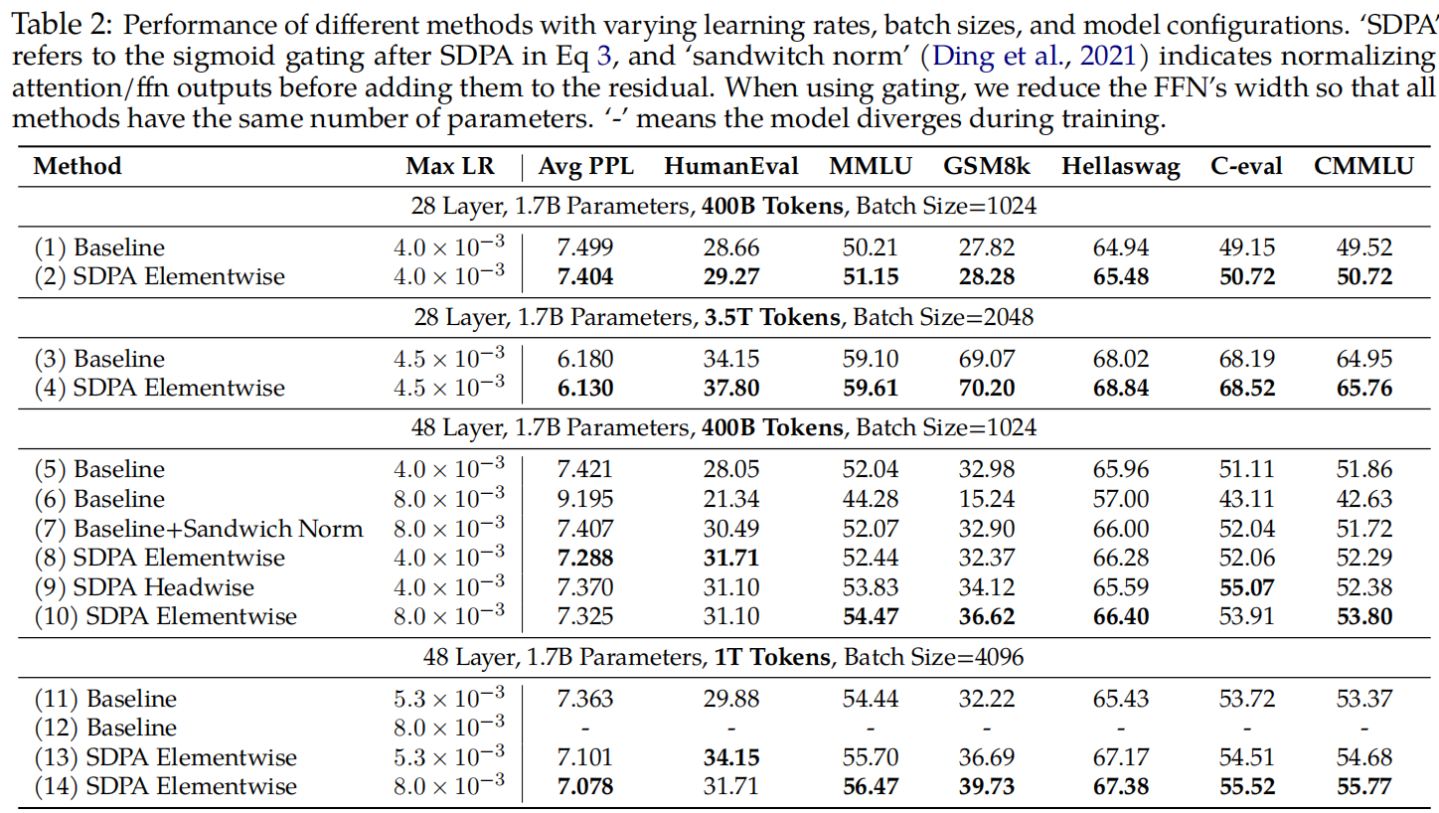
Gated Attention
Experiment(Gated Attention for Dense models)
: (i) Gating is effective across various settings Across various model configurations (row 1 v.s. 2, 5 v.s. 8), training data (row 3 v.s. 4), and hyperparameters (row 11 v.s. 13), applying SDPA output gating consistently yields benefits.
(ii) Gating improves stability and facilitates scaling.
Under the 3.5T token setting, gating improves training stability, largely reducing the loss spike (Fig. 1, right). When increasing the maximum LR, baselines encounter convergence issues (row 6, 12). While adding sandwich norm restores convergence, the improvement is negligible. In contrast, increasing the maximum LR in models with gating results in a noticeable improvement.

Slide 8
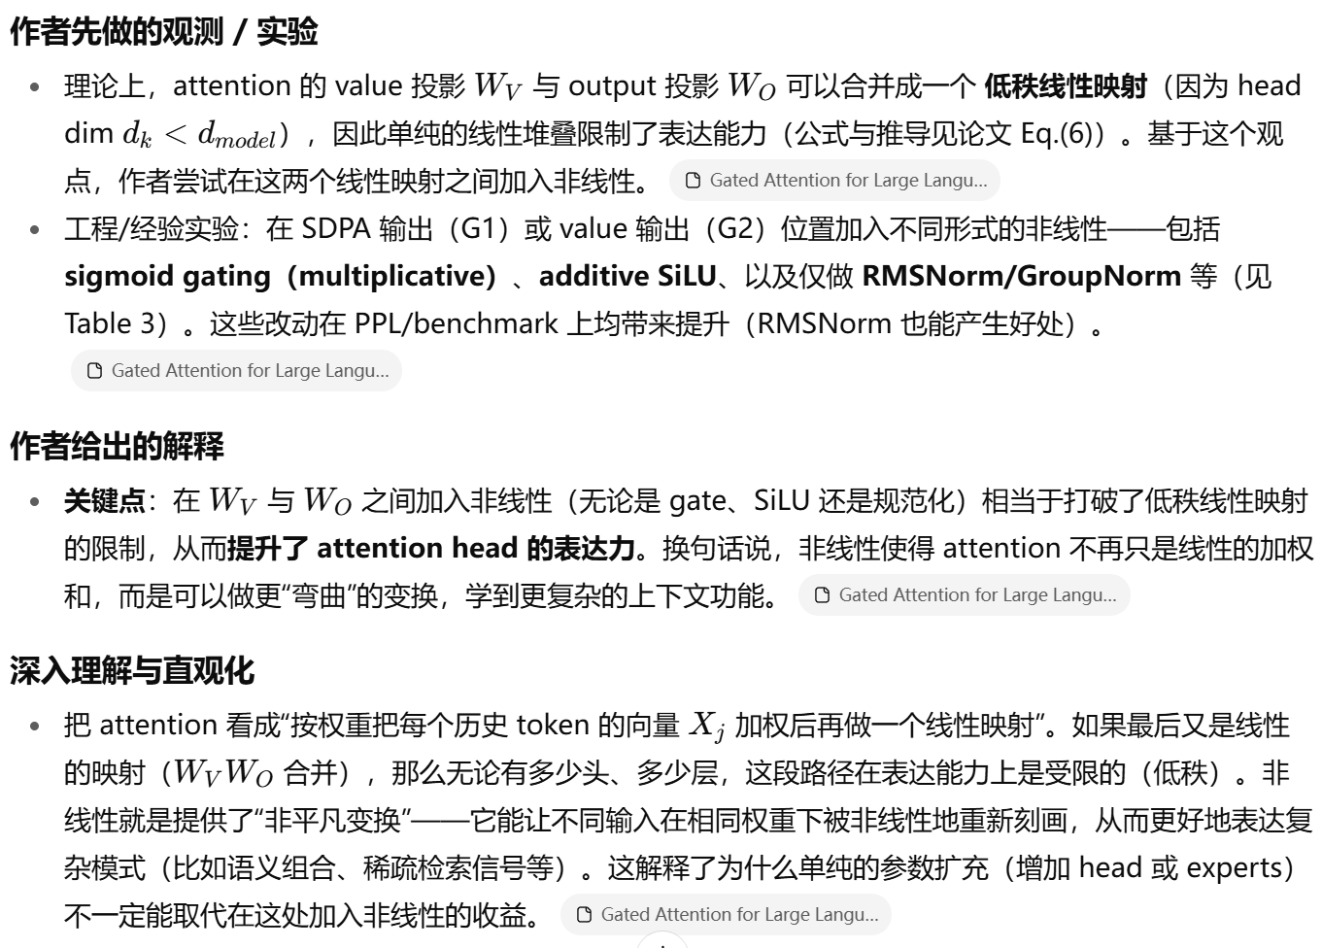
Gated Attention
Non-linearity Improves the Expressiveness of Low-Rank Mapping in Attention

Slide 9
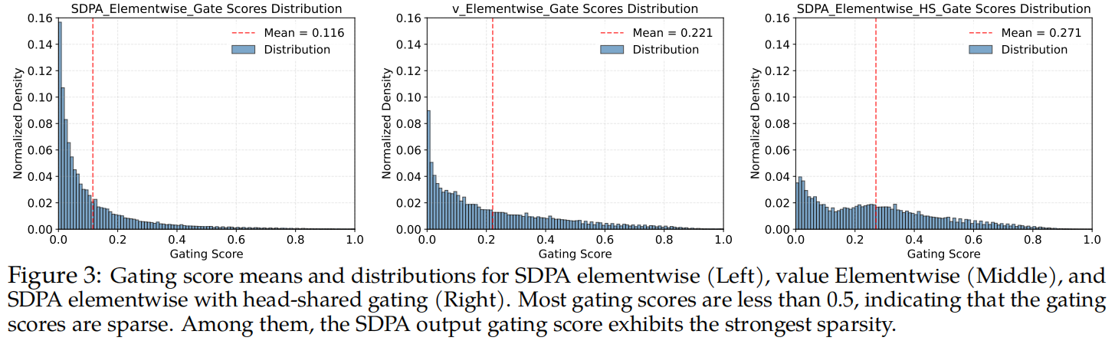
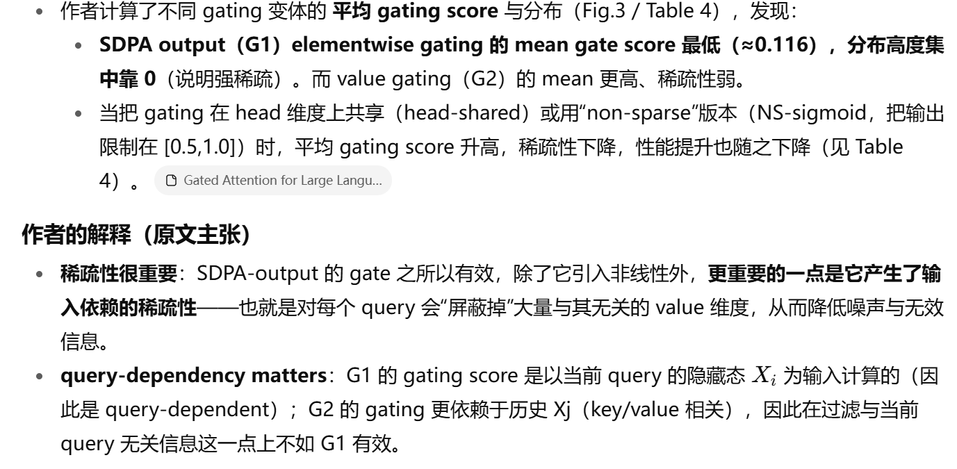
Gated Attention
Gating Introduces Input-Dependent Sparsity

Slide 10
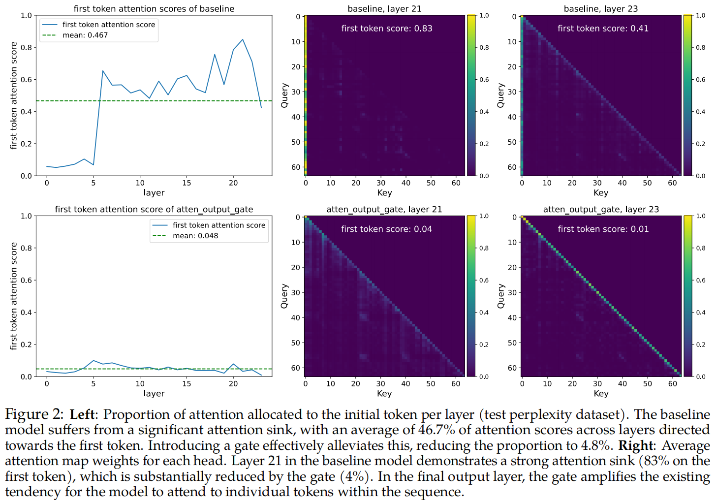
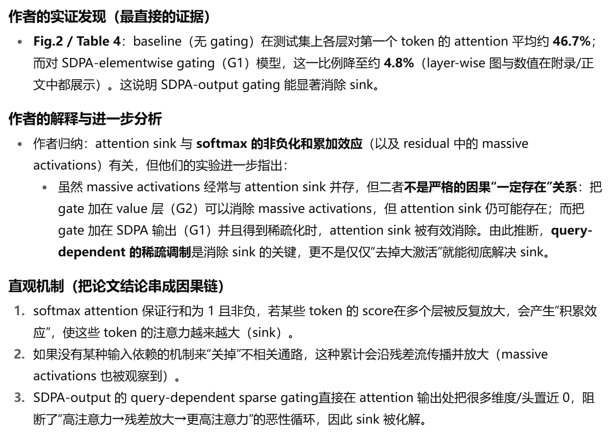
Gated Attention
SDPA Output Gating Reduces Attention-Sink

Slide 11
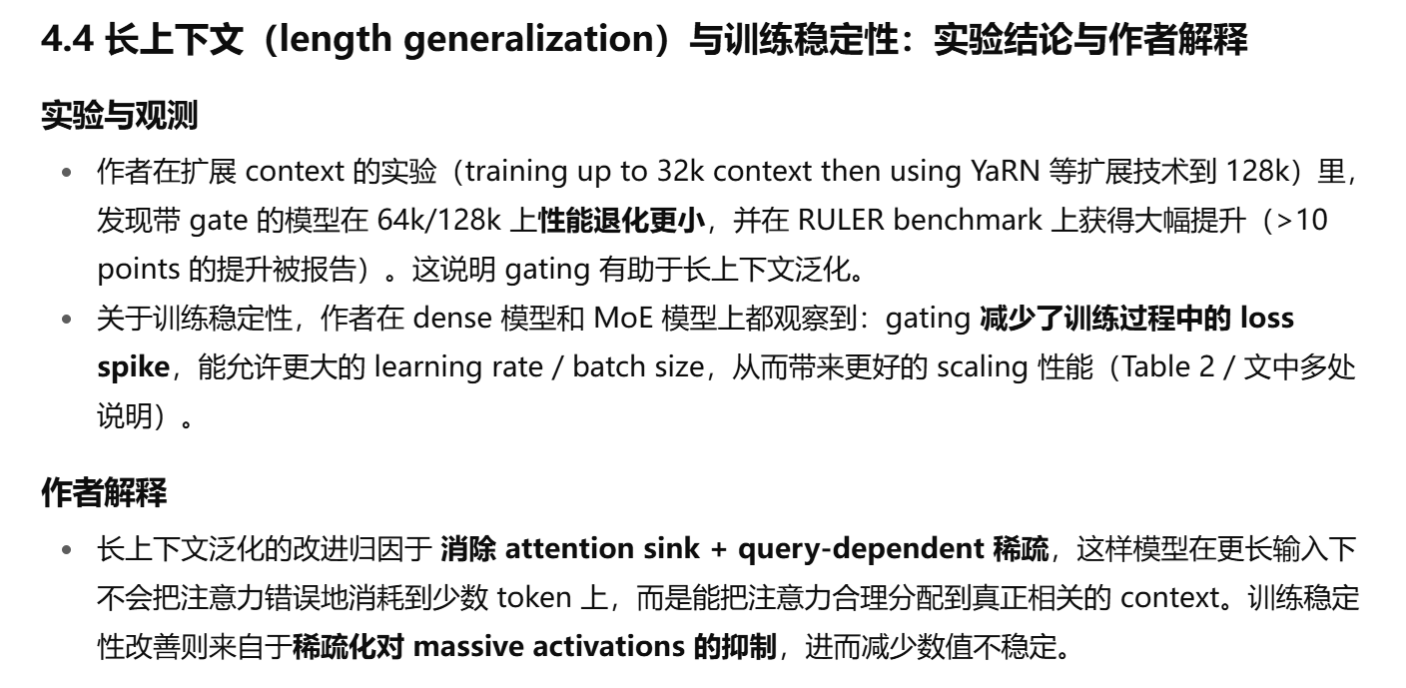
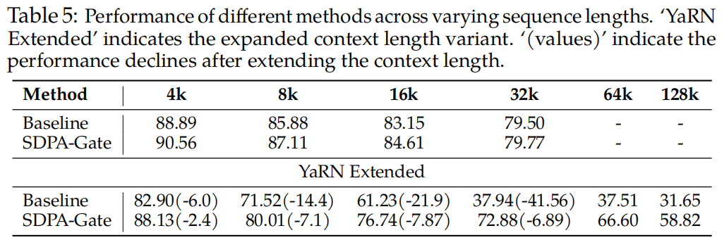
Gated Attention
SDPA Output Gating Facilitates Context Length Extension

Slide 12
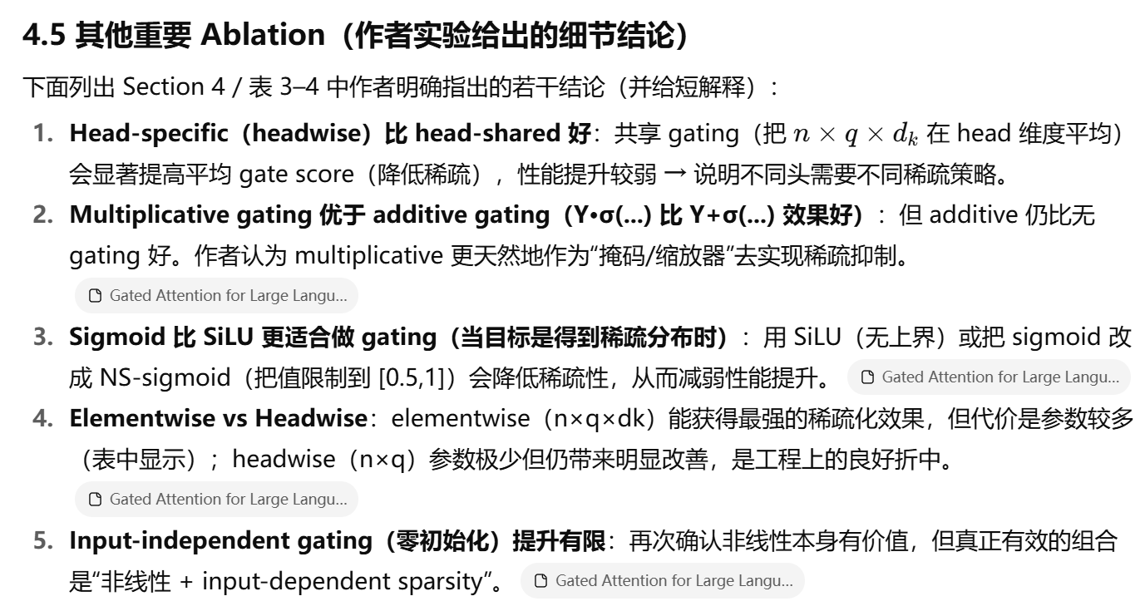
Gated Attention

